Slide 1
Operating System Services –

Slide 2
Objective
To describe the services an operating system provides to users, processes, and other systems.
To discuss the various ways of structuring an operating system.

Slide 3
OS Services
Operating systems provide an environment for execution of programs and services to programs and users
Are the services provided by UBUNTU and Windows the same??
Yes, to an extent. But, there are significant differences. It really matters, buddy!
All the services offered by OS are to make the life of the user convenient and make programming not daunting.
We should not learn theory, in OS! Let’s code is what the above line is saying!!

Slide 4
Conti…
One set of operating-system services provides functions that are helpful to the user:
User interface - Almost all operating systems have a user interface (UI).
Varies between Command-Line (CLI), Graphics User Interface (GUI), Batch
Command Line Interface:
CLI – Open the windows command prompt, that is it! (Best is to learn commands in Linux Shell Terminal)
GUI – Do not type any commands, use mouse! That is it.
Batch Interface:
When you type commands in a file along with details of the path, run the file instead of commands, it is batch! Shell scripting is the best example and we will do it shortly! Hold on!

Slide 5
Conti…
Program execution - The system must be able to load a program into memory and to run that program, end execution, either normally or abnormally (indicating error)
WE DO IT OFTEN with CTRL + ALT + DEL ☺
I/O operations - A running program may require I/O, which may involve a file or an I/O device
Example ???? Can you guys ???
File-system manipulation - The file system is of particular interest. Programs need to read and write files and directories, create and delete them, search them, list file Information, permission management. Managing files is a tough task.
Let’s explore the file systems of Linux, now.

Slide 6
Conti…
Communications – Processes may exchange information, on the same computer or between computers over a network
Communications may be via shared memory or through message passing (packets moved by the OS)
We shall learn on this in IPC.
Error detection – OS needs to be constantly aware of possible errors
May occur in the CPU and memory hardware, in I/O devices, in user program
For each type of error, OS should take the appropriate action to ensure correct and consistent computing
Debugging facilities can greatly enhance the user’s and programmer’s abilities to efficiently use the system

Slide 7
Conti…
Another set of OS functions exists for ensuring the efficient operation of the system itself via resource sharing
Resource allocation - When multiple users or multiple jobs running concurrently, resources must be allocated to each of them
Many types of resources - Some (such as CPU cycles, main memory, and file storage) may have special allocation code, others (such as I/O devices) may have general request and release code.
CPU Scheduling, Printer Handling etc.
Accounting - To keep track of which users use how much and what kinds of computer resources

Slide 8
Conti…
Protection and security - The owners of information stored in a multiuser or networked computer system may want to control use of that information, concurrent processes should not interfere with each other
Protection involves ensuring that all access to system resources is controlled
The owners of information stored in a multiuser or networked computer system may want to control use of that information.
When. several separate processes execute concurrently, it should not be possible for one process to interfere with the others or with the operating system itself
Security of the system from outsiders requires user authentication, extends to defending external I/O devices from invalid access attempts
If a system is to be protected and secure, precautions must be instituted throughout it.

Slide 9
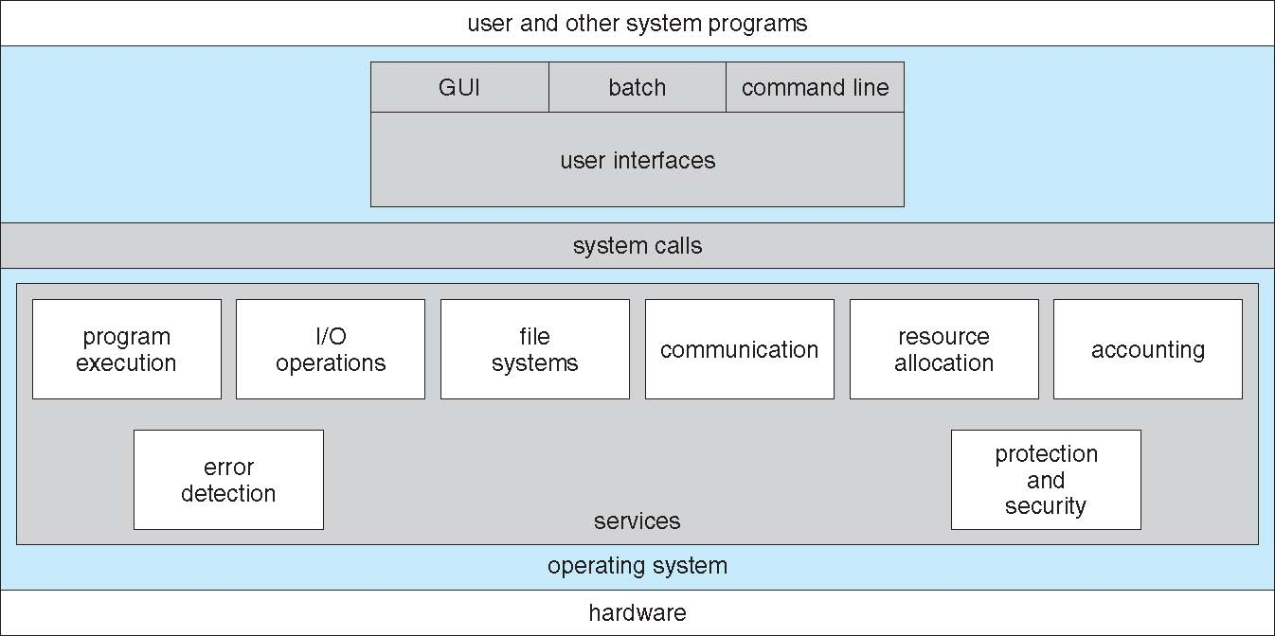
A View of Operating System Services

Slide 10
System Calls
Programming interface to the services provided by the OS
Typically written in a high-level language (C or C++)
Mostly accessed by programs via a high-level Application Program Interface (API) rather than direct system call use
Three most common APIs are Win32 API for Windows, POSIX API for POSIX-based systems (including virtually all versions of UNIX, Linux, and Mac OS X), and Java API for the Java virtual machine (JVM)
Why use APIs rather than system calls?
Program portability- compile and run on any machine that supports API
System calls are more detailed and difficult to work with than the API available
Strong correlation b/w a function and its associated system call within the kernel

Slide 11
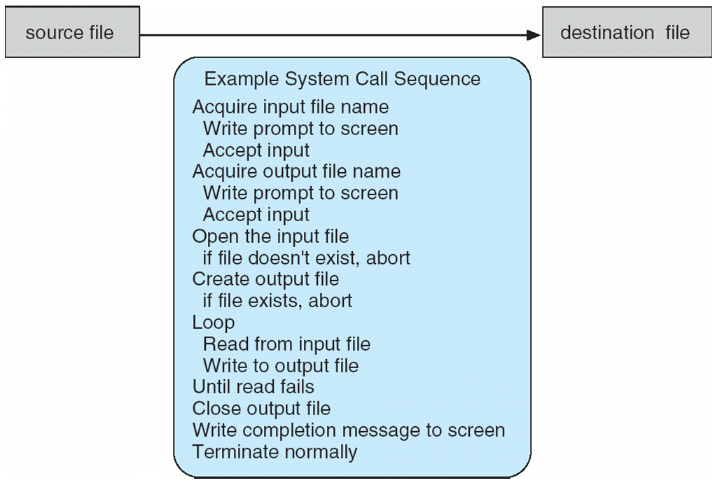
Example of System Calls
System call sequence to copy the contents of one file to another file

Slide 12
Cont…
The first input that the program will need is the names of the two files: the input file and the output file. (you can get the name of the files in many ways, one such is to ask from the user)
Once the two file names are obtained, the program must open the input file and create the output file.
Each of these operations requires another system call.
There are also possible error conditions for each operation. We shall see a few!!

Slide 13
System Call Implementation
Typically, a number associated with each system call
System-call interface maintains a table indexed according to these numbers
The system call interface invokes intended system call in OS kernel and returns status of the system call and any return values
The caller need know nothing about how the system call is implemented
Just needs to obey API and understand what OS will do as a result call
Most details of OS interface hidden from programmer by API
Managed by run-time support library (set of functions built into libraries included with compiler)

Slide 14
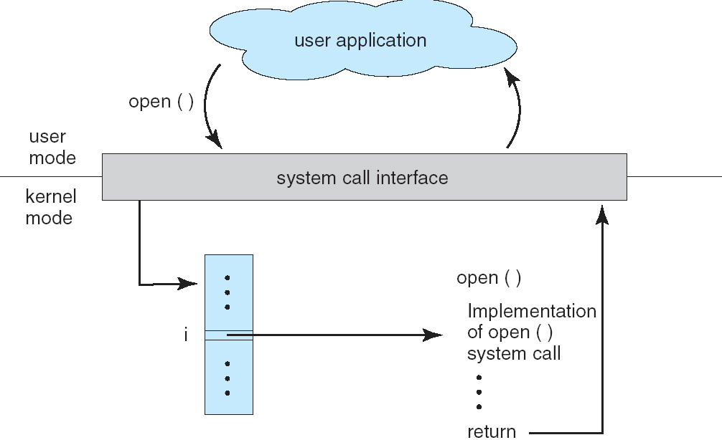
API – System Call – OS Relationship

Slide 15
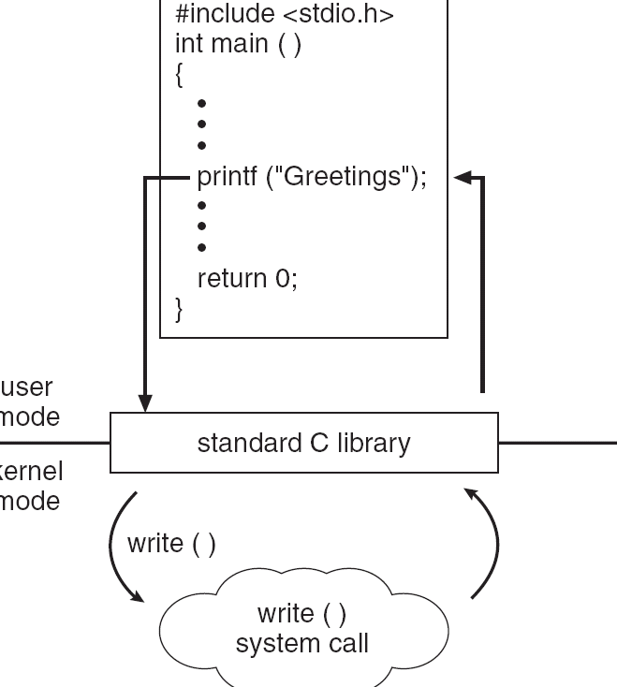
Standard C Library Example
C program invoking printf() library call, which calls write() system call

Slide 16
System Call Parameter Passing
Often, more information is required than simply identity of desired system call
Exact type and amount of information vary according to OS and call
Three general methods used to pass parameters to the OS
Simplest: pass the parameters in registers
In some cases, may be more parameters than registers
Parameters stored in a block, or table, in memory, and address of block passed as a parameter in a register
This approach taken by Linux and Solaris
Parameters placed, or pushed, onto the stack by the program and popped off the stack by the operating system
Block and stack methods do not limit the number or length of parameters being passed

Slide 17
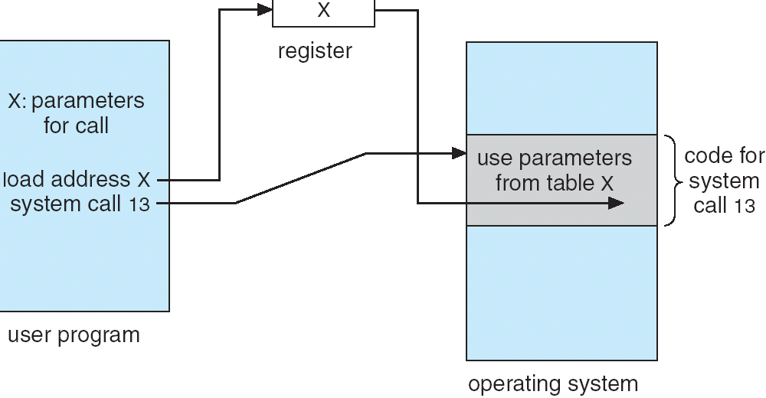
Parameter Passing via Table

Slide 18
Types of System Calls
Process control
File management
Device management
Information maintenance
Communications
Protection

Slide 19
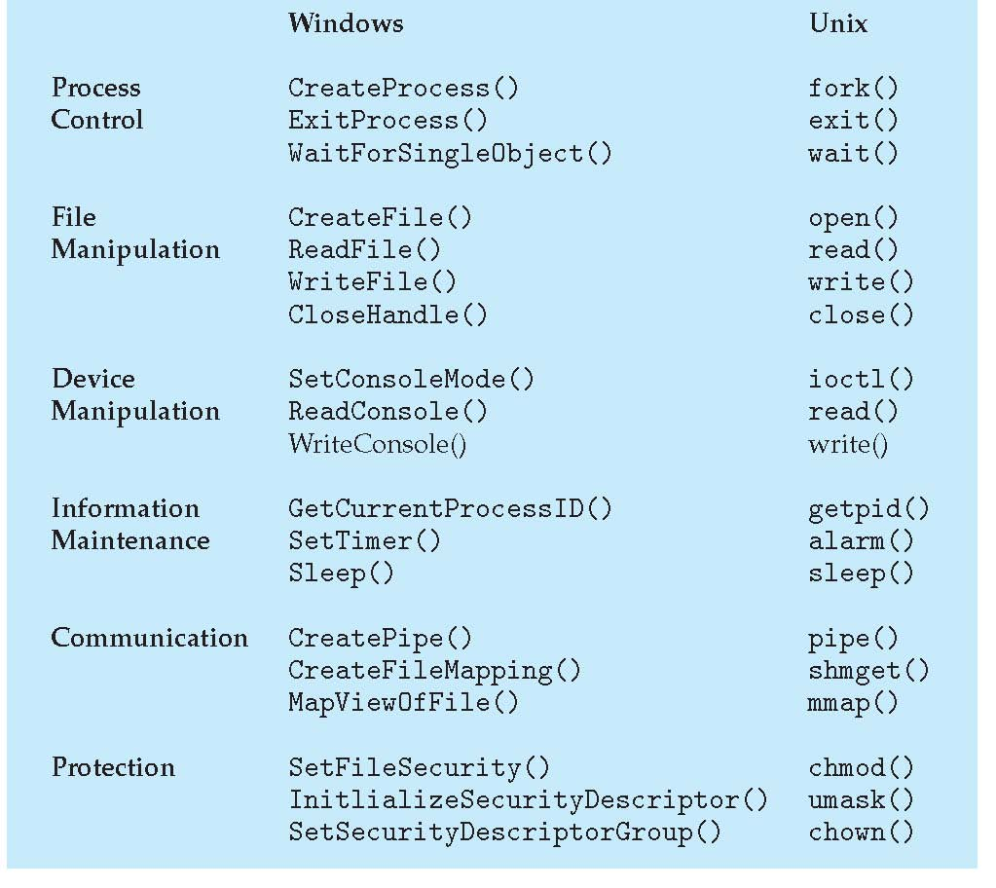
Examples of Windows and Unix System Calls

Slide 20
One Example
What is a process? -
Each process is allocated with a unique number, called process id or PID.
This number will be always a positive integer between 2 to 32,678.
When the process if started the next unused number in the sequence will be allocated.

Slide 21
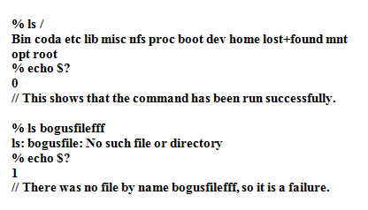

Slide 22
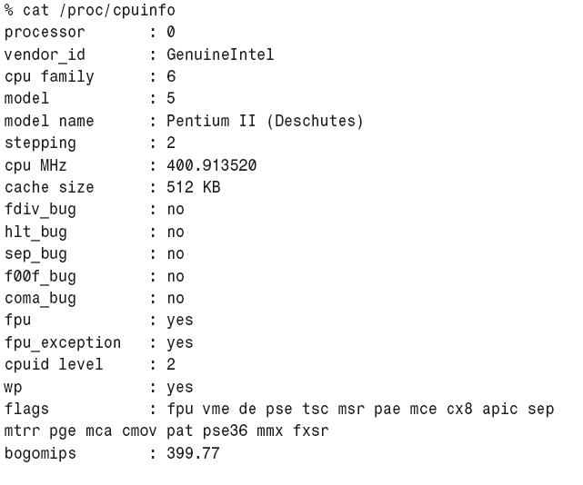
PROC FILESYSTEM

Slide 23
File Descriptor
OS maintains a database called Process Control Block which has details of file descriptors.
File descriptors are numbers allocated to all the files in Linux.
Since everything is file in Linux, Input, Output and Error messages are even denoted by a number and that is referred as file descriptor.
All the file descriptors are updated clearly in a table called file descriptor table in PCB.

Slide 24
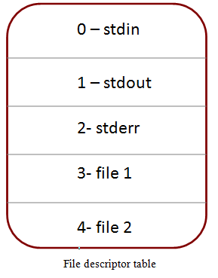
Conti…
The PCB will have following information
Allocated addresses of the CPU register-save memory (Context Switch)
Process state signal mask (when mask is set to 0, the process is allowed to run, and when mask is set to 1, the process is set to run)
Signals
Security and access permissions
File Descriptors
Each process has its own file descriptor table.
Valid descriptor ranges from 0 and maximum number is configurable.
Standard Input – 0, Standard Output – 1 and Standard Error –2 will be present in FD table.

Slide 25
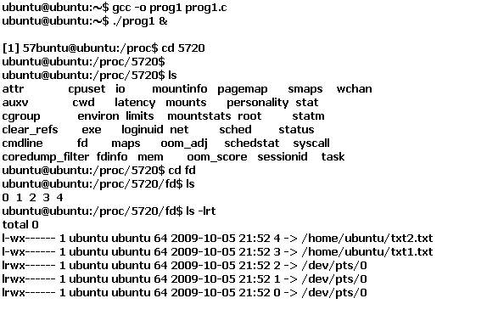
How to view fd

Slide 26
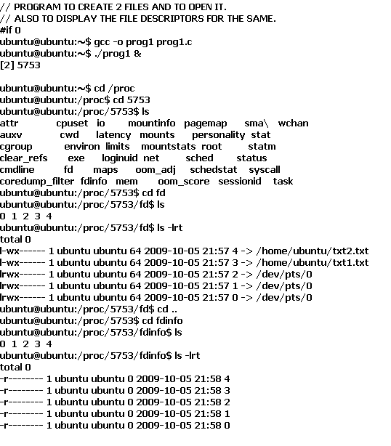
Open () System Call
# include <stdio.h>
# include <fcntl.h>
# include <unistd.h>
int main ()
{
int fd1, fd2;
fd1 = open ("txt1.txt",O_RDONLY|O_CREAT, 0777);
fd2 = open ("txt2.txt",O_RDONLY|O_CREAT, 0777);
while(1)
{
}
}

Slide 27
Dup ()
Dup System call helps you to duplicate the current FD and it will keep the first free spot of File descriptor table.
Normally fd table will have 0,1,2 occupied for i/p o/p and error.
We now are trying to change that. i.e. we are closing fd 2. and we are trying to put our file’s fd in that slot.

Slide 28
DUP
#include<stdio.h>
#include<fcntl.h>
#include<unistd.h>
int main()
{
int fd1, fd2;
fd1=open("txt1.txt",O_RDONLY|O_CREAT,777);
close(2);
dup(fd1);
while(1)
{}
}

Slide 29
[m_prathilothamai@ssh fd]$ ls
0 1 2 3
[m_prathilothamai@ssh fd]$ ls -lrt
total 0
lr-x------ 1 m_prathilothamai m_prathilothamai 64 Jul 21 16:11 3 -> /home/staff/cse/m_prathilothamai/txt1.txt
lr-x------ 1 m_prathilothamai m_prathilothamai 64 Jul 21 16:11 2 -> /home/staff/cse/m_prathilothamai/txt1.txt
lrwx------ 1 m_prathilothamai m_prathilothamai 64 Jul 21 16:11 1 -> /dev/pts/1
lrwx------ 1 m_prathilothamai m_prathilothamai 64 Jul 21 16:11 0 -> /dev/pts/1

Slide 30
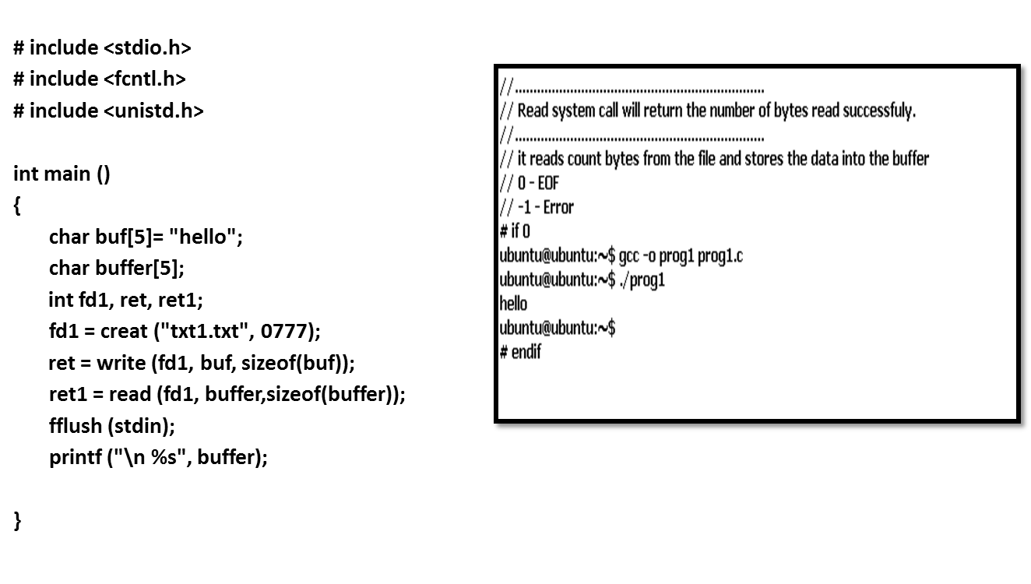
Read and Write System Calls.

Slide 31
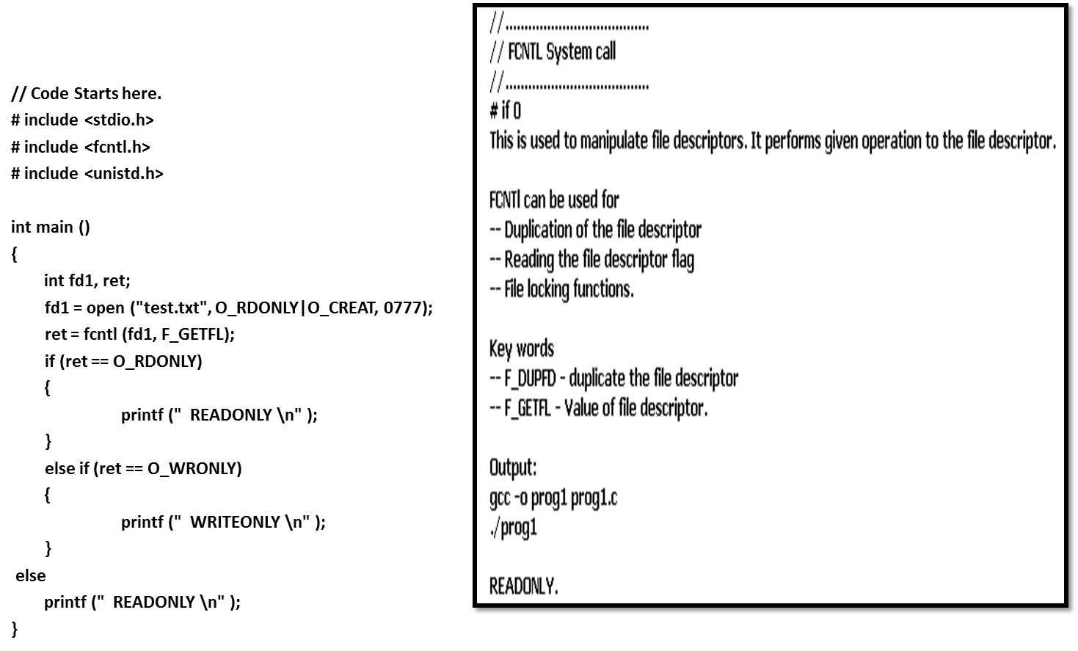
FCNTL System Call

Slide 32
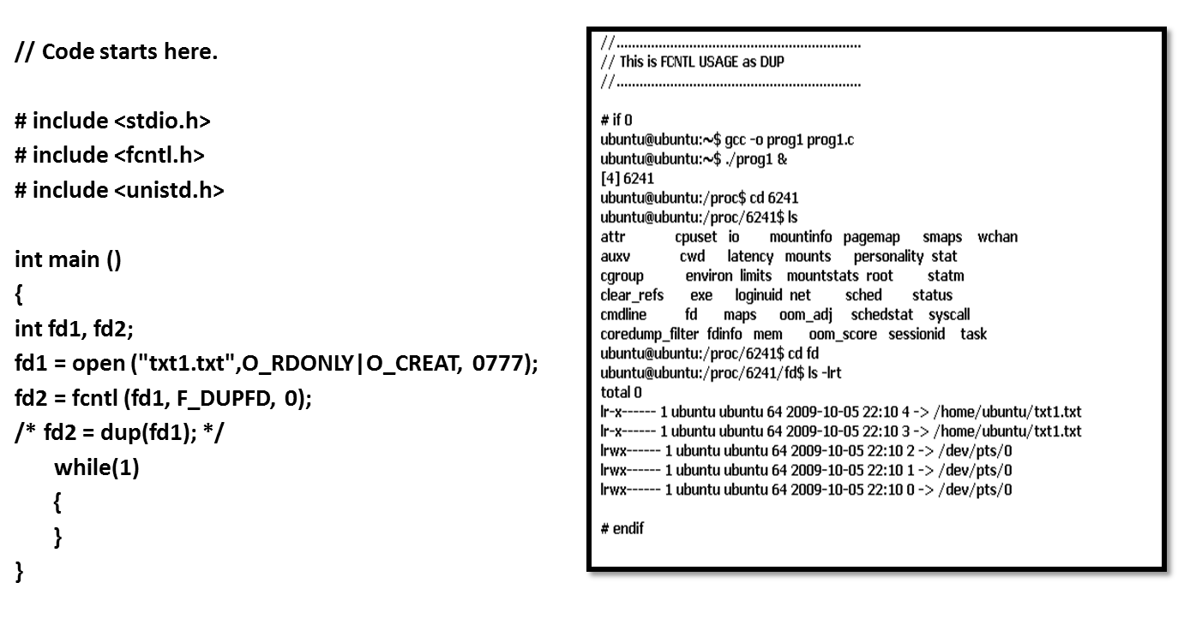
FCNTL as DUP ()

Slide 33
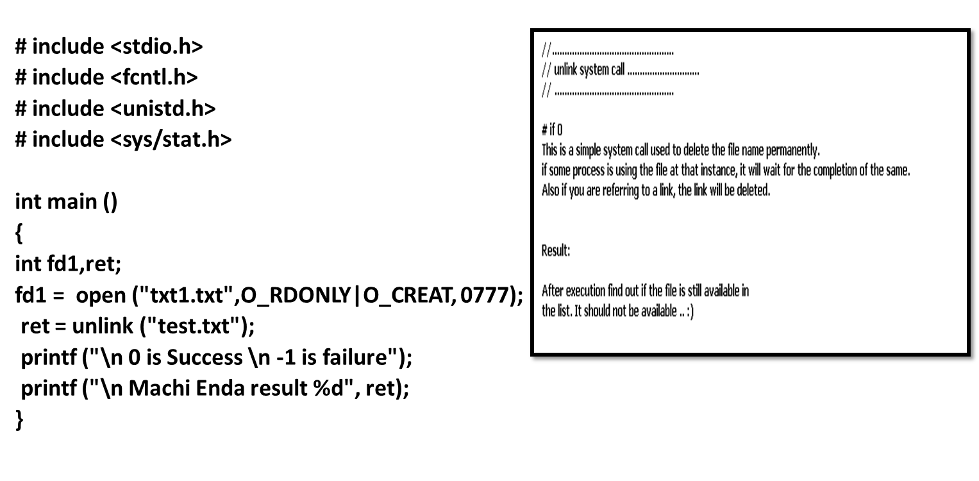
Unlink ()

Slide 34
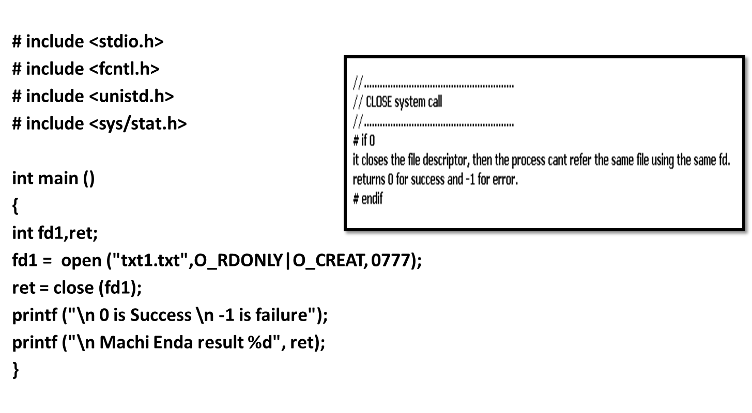
Close ()

Slide 35
Operating System Structure

Slide 36
1. Simple Structure
MS-DOS – written to provide the most functionality in the least space
Not divided into modules carefully
Although MS-DOS has some structure, its interfaces and levels of functionality are not well separated
Appln prgms :can write directly to the display
But error in user prgm: cause entire system crash

Slide 37
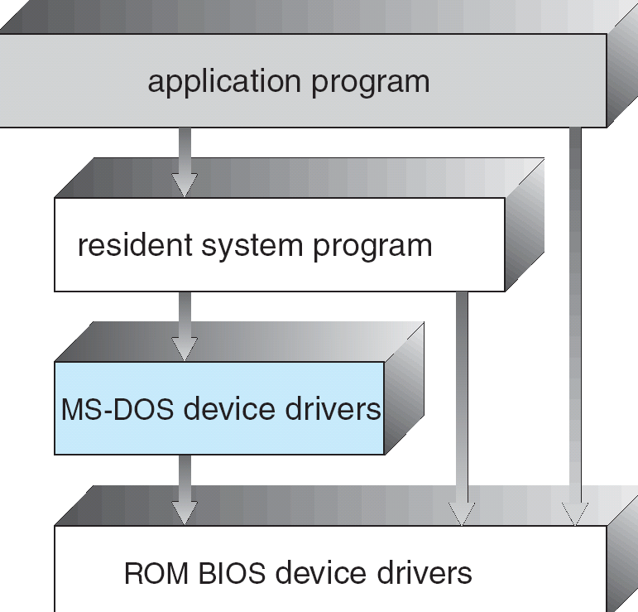
MS-DOS Layer Structure

Slide 38
2. Layered Approach
The operating system is divided into a number of layers (levels), each built on top of lower layers. The bottom layer (layer 0), is the hardware; the highest (layer N) is the user interface.
With modularity, layers are selected such that each uses functions (operations) and services of only lower-level layers

Slide 39
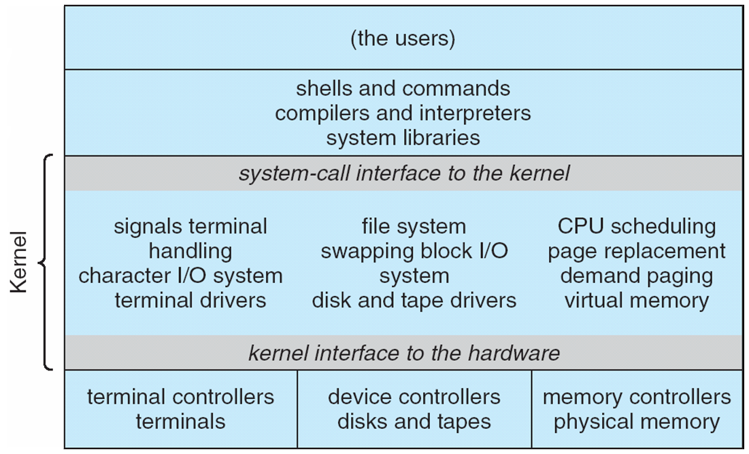
Traditional UNIX System Structure

Slide 40
UNIX
UNIX – limited by hardware functionality, the original UNIX operating system had limited structuring. The UNIX OS consists of two separable parts
Systems programs
The kernel
Consists of everything below the system-call interface and above the physical hardware
Provides the file system, CPU scheduling, memory management, and other operating-system functions; a large number of functions for one level

Slide 41
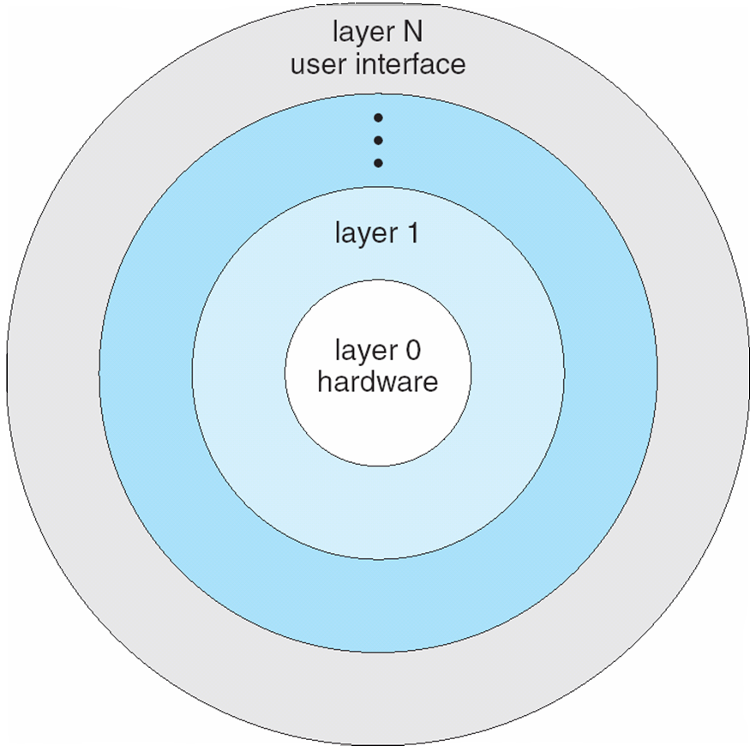
Layered Operating System

Slide 42
3. Microkernel System Structure
Moves as much from the kernel into “user” space
Communication takes place between user modules using message passing
Benefits:
Easier to extend a microkernel
Easier to port the operating system to new architectures
More reliable (less code is running in kernel mode)
More secure
Detriments:
Performance overhead of user space to kernel space communication

Slide 43
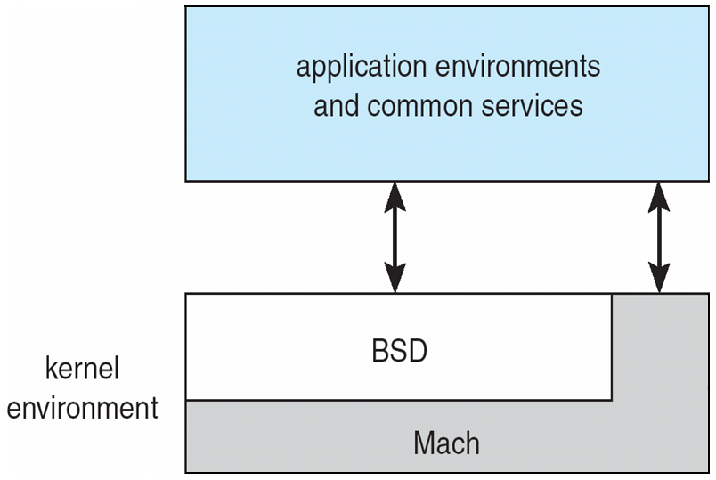
Mac OS X Structure

Slide 44
4. Modules
Most modern operating systems implement kernel modules
Uses object-oriented approach
Each core component is separate
Each talks to the others over known interfaces
Each is loadable as needed within the kernel
Overall, similar to layers but with more flexible

Slide 45
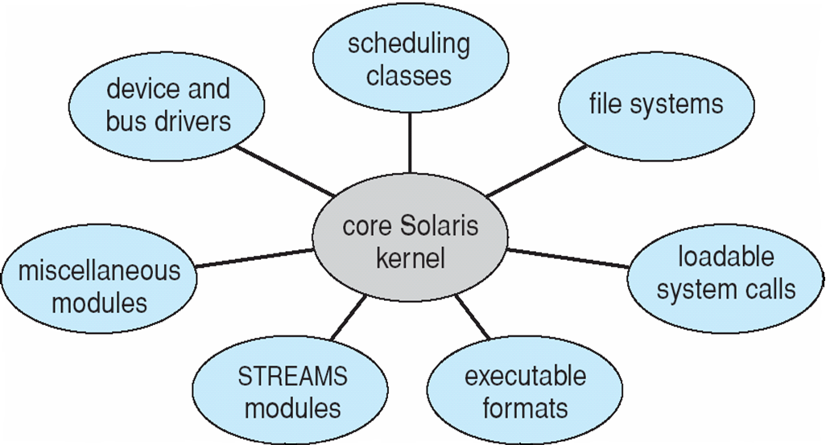
Solaris Modular Approach

Slide 46

Virtualization
Virtualization deals with “extending or replacing an existing interface so as to mimic the behavior of another system”
Virtual system examples: virtual private network, virtual memory, virtual machine

Slide 47
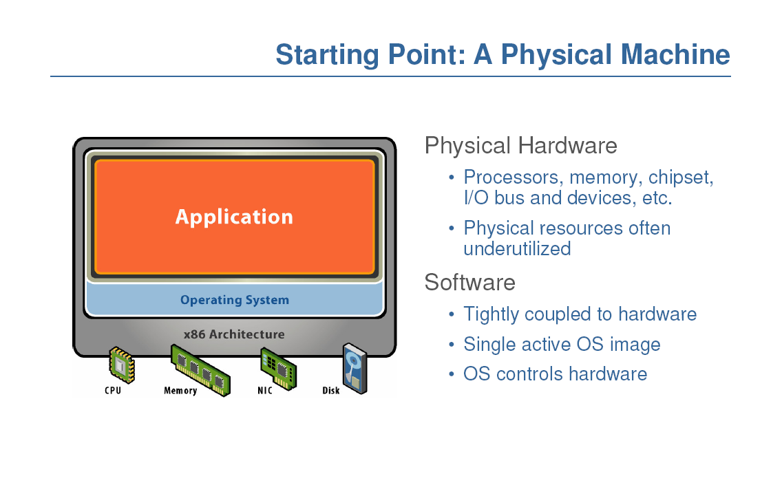

Slide 48
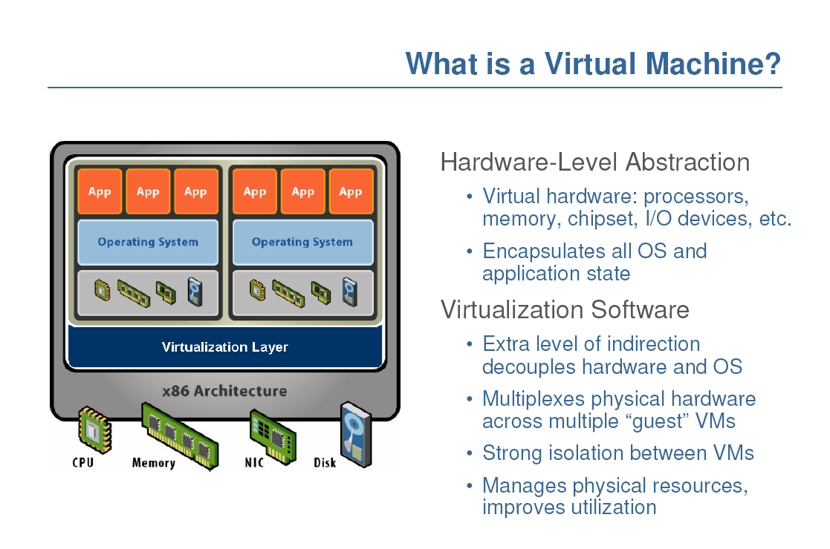

Slide 50
Three Virtualization Approaches
Full Virtualization
Paravirtualization
Hardware-assisted Virtualization

Slide 51
Full Virtualization
Everything is virtualized
Full hardware emulation
Pros
Disaster recovery, failover
Virtual appliance deployment
Legacy code on non-legacy hardware
Cons – LATENCY of core four resources
RAM performance reduced 25% to 75%
Disk I/O degraded from 5% to 20%
Network performance decreased up to 10%
CPU privileged instruction dings nearing 1% to 7%

Slide 52
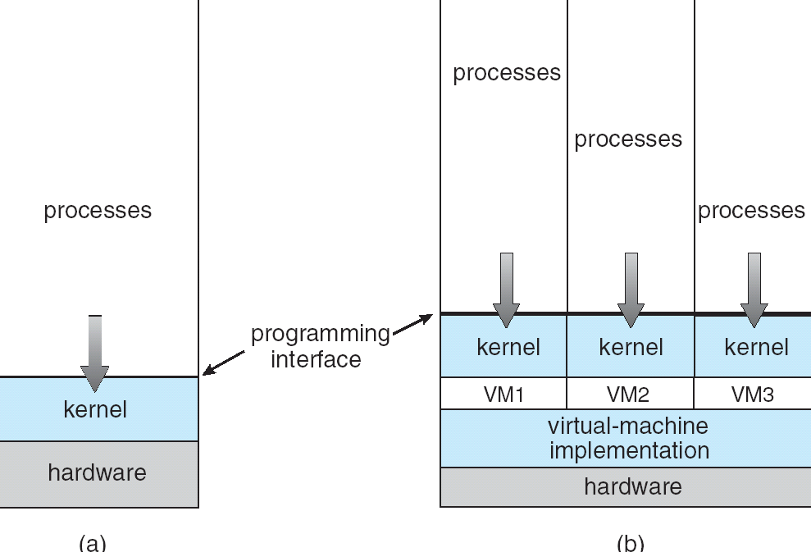
(a) Nonvirtual machine (b) virtual machine

Slide 53
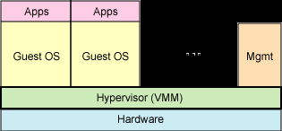
Full virtualization uses a hypervisor to share the underlying hardware

Slide 54
Para-virtualization
Presents guest with system similar but not identical to hardware
Guest must be modified to run on paravirtualized hardware
Guest can be an OS, or in the case of Solaris 10 applications running in containers.
paravirtualization is a virtualization technique that presents a software interface to virtual machines that is similar, but not identical to that of the underlying hardware.
Solaris 10 includes containers or zones: create a virtual layer between the OS and the applications
Only one kernel is installed & hardware is not virtualized
Os and its devices are virtualized
Processes within the container-impression that they are the only processes on the system.
One or more containers can be created: each have its own applications, network stacks, network address and ports , user accounts so on.

Slide 55
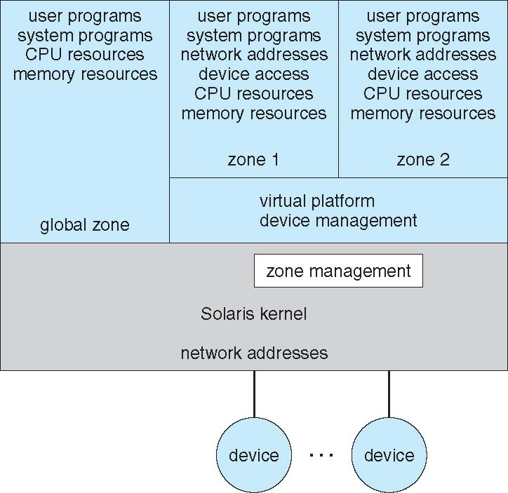
Solaris 10 with Two Containers

Slide 56
Implementation
VM: It is very difficult to implement
Much work is required for creating exact duplicate
Underlying machine has 2 modes:
Virtual machine software runs in kernel mode
Vm will execute in user mode
Virtual user mode and kernel mode : work in physical user mode
Actions which transfer from user mode to kernel mode in real machine must also cause the transfer from virtual user mode to virtual kernel mode

Slide 57
Conti…
When system call made on VM in virtual user mode
Transfer the control to VMM in real machine
When VMM gains control, it can change the register contents and program counter for the VM-to simulate the effect of the sys call
Virtual I/O might take less time(spooled) or more time(interpreted)
If the guest tries to access a virtualized resource, then control passed to the host to manage that interaction

Slide 58
VMWare
Another method: writing the virtualization tool to run in user mode as an application on top of the OS
Vmware workstation is a popular commercial application
Vmware runs as an appln on a host os( windows or linux) allows the host to concurrently run several different guest os as independent virtual machines
Virtualization layer is the heart of the Vmware-it abstract the physical hardware into isolated vms running as guest os

Slide 59
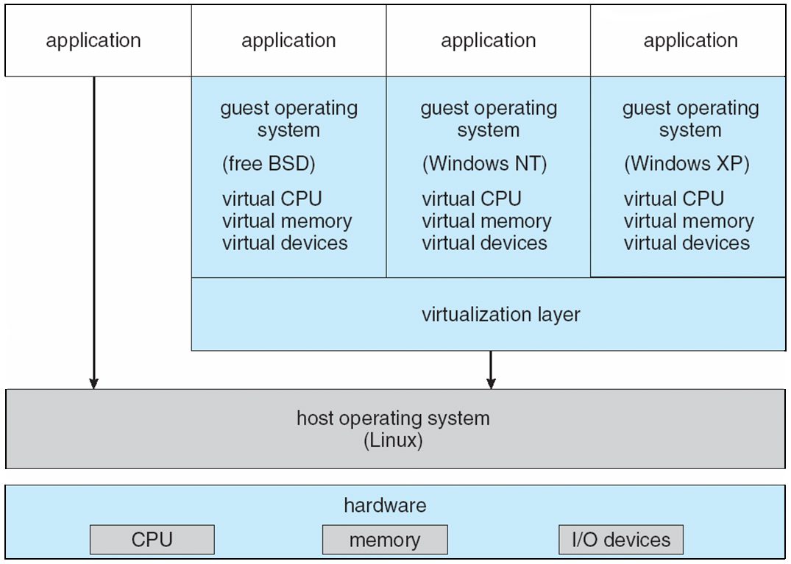
VMware Architecture

Slide 60
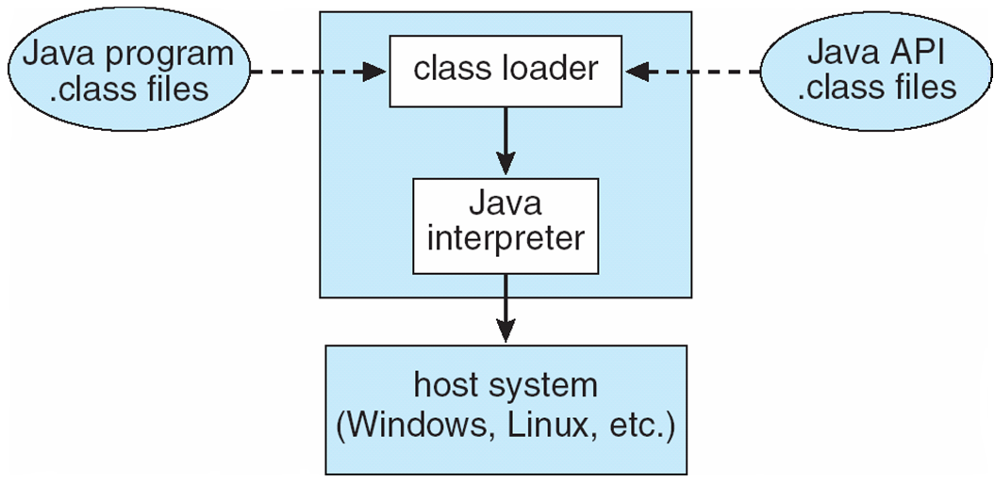
The Java Virtual Machine

Slide 61
JVM
Each java class compiler produces an architecture-neutral bytecode output(.class)
JVM-specification for an abstract computer
Consists of class loader and java interpreter- executes bytecode
Class loader : that loads .class file from both java prg and API for execution
After a class is loaded, verifier that checks that .class file is valid bytecode
JVM automatically manages memory by garbage collection- objects no longer used

Slide 62
Conti…
first java method is invoked, the bytecodes for the method are tuned into native mc lang for host
These operations are cached so subsequent invocations of method are performed using native machine instructions and bytecode need not be interpretted again
JVM in hardware: chip
JVM in S/W: JIT, Faster.

